Slide 1

Predicting Red Wine Quality
https://youtu.be/CQlzZviEabk
LIS4761 - Data Mining and Analytics
Instructor: Dr. Zhe He
Presenters: Tyler Perry, Fabio Nasseh, Mehmet Ozmen

Slide 2

Introduction
The producers of wine have a keen interest in determining the quality of their wines in order to more efficiently price and market different red wine varieties. The goal of our project is to help producers and distributors of red wine assess their pricing and distribution strategy by (1) determining which attributes have the strongest effect on wine quality, and (2) developing a classification model to accurately predict the quality of red wine variants.
Notes:
Fabio

Slide 3
Dataset / Attributes
Dataset:
Red Wine Quality: www.kaggle.com/uciml/red-wine-quality.
This dataset contains physicochemical and sensory data on red wine variants of the Portuguese “Vinho Verde” wine. (n=1,599)
Attributes:
Input variables: Volatile acidity, total sulfur dioxide, density, chlorides, pH, free sulfur dioxide, residual sugar, fixed acidity, citric acid, sulphates, alcohol.
Output variable: Quality
Notes:
Fabio

Slide 4
Data Acquisition and Tools Used
The dataset is an Open Database, available for free on Kaggle. We downloaded the dataset as a CSV file and opened it in Google Sheets.
The CSV file was imported into Google Sheets for basic data cleaning. Then, we used the “CSV import” function in Orange3 to create data visualizations to better understand the data. We used Weka to preprocess the data and apply classification experiments.
Our team utilized a text message group chat to communicate throughout the week. We also utilized Zoom to meet synchronously and break down the workload for each week.
Notes:
Fabio

Slide 5
Attribute |  | Mean | Median | Min | Max
1 | fixed acidity | 8.3196 | 7.9 | 4.6 | 15.9
2 | volatile acidity | 0.5278 | 0.52 | 0.12 | 1.58
3 | citric acid | 0.2710 | 0.26 | 0.00 | 1
4 | residual sugar | 2.5389 | 2.2 | 0.9 | 15.5
5 | chlorides | 0.0875 | 0.079 | 0.012 | 0.611
6 | free sulfur dioxide | 15.8749 | 14 | 1 | 72
7 | total sulfur dioxide | 46.4678 | 38 | 6 | 289
8 | density | 0.9967 | 0.9967 | 0.99 | 1
9 | pH | 3.3111 | 3.31 | 2.74 | 4.01
10 | sulphates | 0.658 | 0.62 | 0.33 | 2
11 | alcohol | 10.423 | 10.2 | 8.4 | 14.9
12 | quality | 5.64 | 6 | 3 | 8
Characteristics of the Dataset
In order to gain a better understanding of the data, we used Orange3 to find the feature statistics for each attribute provided in the dataset.
Notes:
Tyler
The first thing we did to try to understand the data a bit better was to run the feature statistics for each attribute using Orange3. This gave us a better idea of the data that we were working with. For instance, we found out that most wines had an alcohol level of around 10, and were rated at a quality level of around 5.6. There are only 5 qualities of wine represented, none of the wines available to us in the dataset scored below a 3 or higher than an 8.

Slide 6
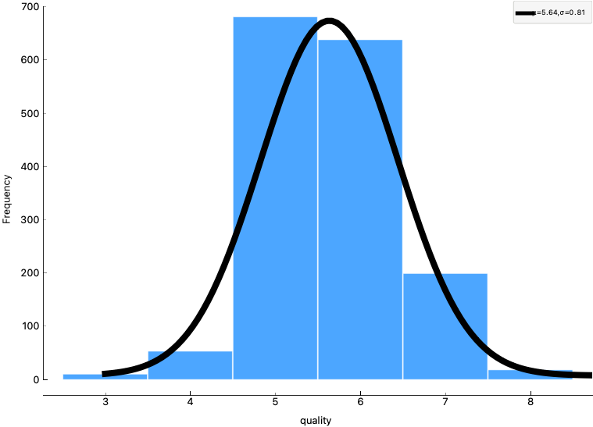
Characteristics of the Dataset
Since our dependent variable is quality, we used Orange3 to run a distribution graph of the attribute. We found that six wine qualities are represented in the dataset, ranging from 3 to 8. The distribution is normal, with the quality of most wines falling in the middle.
Notes:
Tyler
Since we were using wine quality as our dependent variable, we wanted to get a better look at the distribution in quality amongst all 1,599 red wines. We used Orange3 to run a distribution graph of the attribute. We found that six wine qualities are represented in the dataset, ranging from 3 to 8. What we found is that most wines fall into the 5 and 6 category, and the distribution is normal.

Slide 7
X | Y | Correlation | Correlation Coefficient (r)
quality | volatile acidity | negative correlation | -0.390
quality | total sulfur dioxide | negative correlation | -0.185
quality | density | negative correlation | -0.175
quality | chlorides | negative correlation | -0.129
quality | pH | negative correlation | -0.058
quality | free sulfur dioxide | negative correlation | -0.051
quality | residual sugar | positive correlation | 0.014
quality | fixed acidity | positive correlation | 0.120
quality | citric acid | positive correlation | 0.230
quality | sulphates | positive correlation | 0.251
quality | alcohol | positive correlation | 0.476
Characteristics of the Dataset
To determine the effect of each variable on quality, we used Orange3 to run a correlation analysis of our independent variables against the dependent variable, quality.
Notes:
Tyler
Since quality is our dependent variable, and the other 11 attributes were independent variables, we wanted to attempt to determine the effect of each attribute on quality. We used Orange3 to run a correlation analysis which produced an r value, or the correlation coefficient. An r value closer to 1 represents a strong correlation, and a value closer to 0 represents a weaker correlation. The variables with the highest correlation were alcohol, volatile acidity, and sulphates. The variables with the lowest correlation were pH, free sulfur dioxide, and residual sugar. Since those three variables had an r value of less than 0.1, we determined those to be irrelevant variables.

Slide 8
Data Preprocessing
The dataset has already been cleaned, so there was no need to apply additional data cleaning. Only discretization was performed.
First, I created a new categorical attribute, Quality Category, using the Wine Quality attribute. I used an IF statement in Excel to split the numerical quality values into three classes: Poor, Good, and Excellent.
After the csv file was imported into Weka, the nominal quality attribute was removed. Then, the remaining numerical variables were automatically discretized from a range of numeric attributes into nominal by using the first-last method with a precision of 10 in Weka.
Notes:
Tyler.
Now that we have a better idea of the data that we are working with, we wanted to preprocess that data before we could begin data analysis.
The dataset had already been cleaned, so there was no need to apply additional cleaning. There were no outliers, there were no missing data.
The first thing we had to do was establish a categorical attribute. We used the nominal wine quality attribute to create a new attribute, quality category.
In Excel, we used an IF statement to split the numeric values into three classes: poor, good, and excellent.
Then, we imported the file into Weka, and removed the quality attribute. The remaining numerical variables were automatically discretized from a range of numeric attributes into nominal by using the first-last method with a precision of 10.

Slide 9
Data Modeling and Evaluation
Three classification models, Random Forest, Random Tree, and Naïve Bayes were applied to the dataset. In Weka, the datasets are separated into training and testing sets by using 10-fold cross validation.
We applied the models first with all attributes, and then after removing irrelevant attributes (residual sugar, free sulfur dioxide, and pH) and compared the results.
Notes:
Mehmet
In our datasets, we used three classifications methods which are random forest, random tree, and naive bayes. In Weka, we separated datasets into training and testing sets by using 10-fold cross validation. We ran each models, one with all attributes and the another without the irrelevant attributes and compared them to get results.

Slide 10
Classification Model |  | Accuracy | Precision | Recall | F1
1 | Random Forest, all attributes | 82.364% | 0.794 | 0.824 | 0.806
2 | Random Forest, only relevant attributes | 82.6767% | 0.794 | 0.827 | 0.807
3 | Naive Bayes, all attributes | 82.0513% | 0.824 | 0.821 | 0.820
4 | Naive Bayes, only relevant attributes | 82.6141% | 0.827 | 0.826 | 0.824
5 | Random Tree, all attributes | 81.8637% | 0.790 | 0.819 | 0.802
6 | Random Tree, only relevant attributes | 82.4891% | 0.790 | 0.825 | 0.801
Notes:
Mehmet
After removing the 3 irrelevant attributes, we saw that random forest has the best accuracy as well as best recall out of all the classification methods.

Slide 11
Results
Classification Model |  | Accuracy
1 | Random Forest, all attributes | 82.364%
2 | Random Forest, only relevant attributes | 82.6767%
3 | Naive Bayes, all attributes | 82.0513%
4 | Naive Bayes, only relevant attributes | 82.6141%
5 | Random Tree, all attributes | 81.8637%
6 | Random Tree, only relevant attributes | 82.4891%
The accuracy of a classification experiment is measured by the percent of correctly identified instances. All models performed better after removing irrelevant attributes. We defined the three irrelevant attributes as the three attributes with the lowest correlation to quality.
Notes:
Mehmet
All models performed better after removing irrelevant attributes. Random Forest model (Model 2) classified the instances into their appropriate class 82.68% of the time. By comparison, the Naive Bayes model (Model 4) classified the instances correctly 82.61% of the time, and the Random Tree model (Model 6) was correct 82.49% of the time.

Slide 12
Results
Classification Model |  | Accuracy | F1
1 | Random Forest, all attributes | 82.364% | 0.806
2 | Random Forest, only relevant attributes | 82.6767% | 0.807
3 | Naive Bayes, all attributes | 82.0513% | 0.820
4 | Naive Bayes, only relevant attributes | 82.6141% | 0.824
5 | Random Tree, all attributes | 81.8637% | 0.802
6 | Random Tree, only relevant attributes | 82.4891% | 0.801
In cases like ours, where class distribution is uneven, the F1 score is often more useful. The F1 score is the weighted average of precision and recall, and takes both false positives and false negatives into account. The Naive Bayes model (Model 4) scored the highest with a F-measure of 82.4% after irrelevant attributes were removed.
Notes:
Mehmet
Even though Random Forest scored the highest accuracy in our tests, accuracy isn’t always the best measure to use when determining the effectiveness of a model. Naive Bayes had an F-measure of 0.824. The f1 score is the weighted average of precision and recall, and takes into account both false positives and false negatives. In cases like ours, where class distribution is uneven, the F1 score is often more useful.
So, the Naive Bayes model with the irrelevant attributes removed was the most effective model at predicting the quality of red wine.

